Slide 1
AI-Powered Personalised Learning Coach
CAPSTONE PROJECT
LearnMate
Presented By-
Student name: Niyati
College Name: Jims Engineering Management Technical Campus (JEMTEC, Greater Noida)
Department: Artificial Intelligence & Data Science (AI&DS)

Slide 2
OUTLINE
Problem Statement
Technology used
Wow factor
End users
Result
Conclusion
Future scope
IBM Certifications
GitHub Link

Slide 3
Problem Statement
The Learning Pathway Challenge
Students across all academic levels face significant challenges in navigating the complex landscape of online education.
The Current Issues include:
An overwhelming volume of online courses.
Lack of personalised guidance for students.
Static learning paths that don’t adapt to progress.
The Impact of it:
60% of learners drop out due to mismatched courses (cite source if available).
Wasted time/resources on irrelevant content.
1000s of Courses
Dropouts.
Mismatched Learning

Slide 4
Problem Statement
Student Input
Skill Assessment
Dynamic Pathway
Progress Tracking
PROPOSED SOLUTION
LearnMate AI Agent
Agentic AI Coach that:
Interview students to assess interests/skill levels.
Dynamically generates personalised course roadmaps.
Adapts recommendations based on progress (e.g., slows pace if struggling).
Key Differentiator:
Real-time adaptation (vs. static MOOC platforms).

Slide 5
Technology used
IBM Watsonx.ai Granite foundation model (13B parameters)
Retrieval-Augmented Generation (RAG) for course recommendations
Natural Language Processing for student interaction analysis

Slide 6
IBM cloud services used
IBM Watsonx AI Studio - For model training and deployment
IBM Watsonx AI Runtime - For scalable inference
IBM Cloud Agent Lab - For conversational AI development
IBM Cloudant Database - For student profile storage

Slide 7
Wow factors
Why LearnMate Stands Out?
Adaptive Pathways: Adjusts weekly based on quiz scores/time spent.
Multimodal Recommendations: Videos, articles, projects tailored to learning style.
Career-Aware: Suggests courses aligned with job market trends (e.g., AI prompt engineering).
Progress Analytics: Visual dashboards for students/mentors.

Slide 8
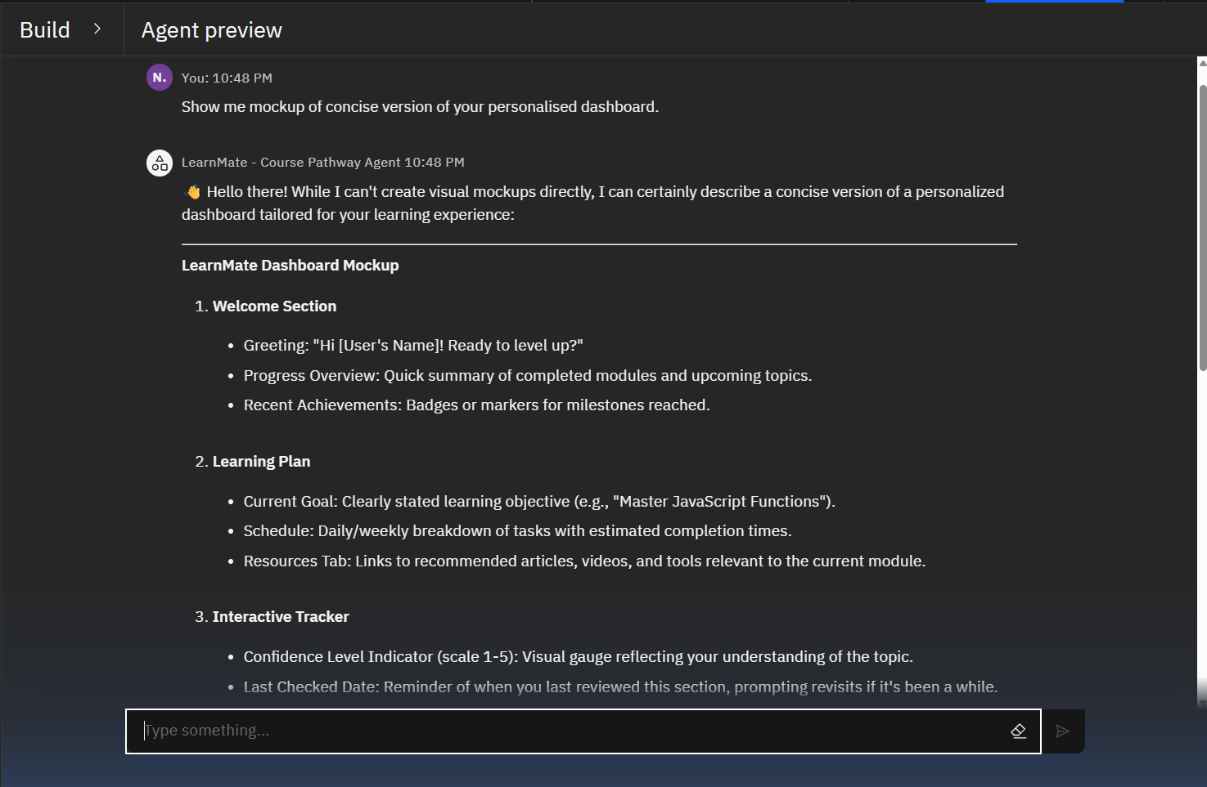
Wow factors

Slide 9
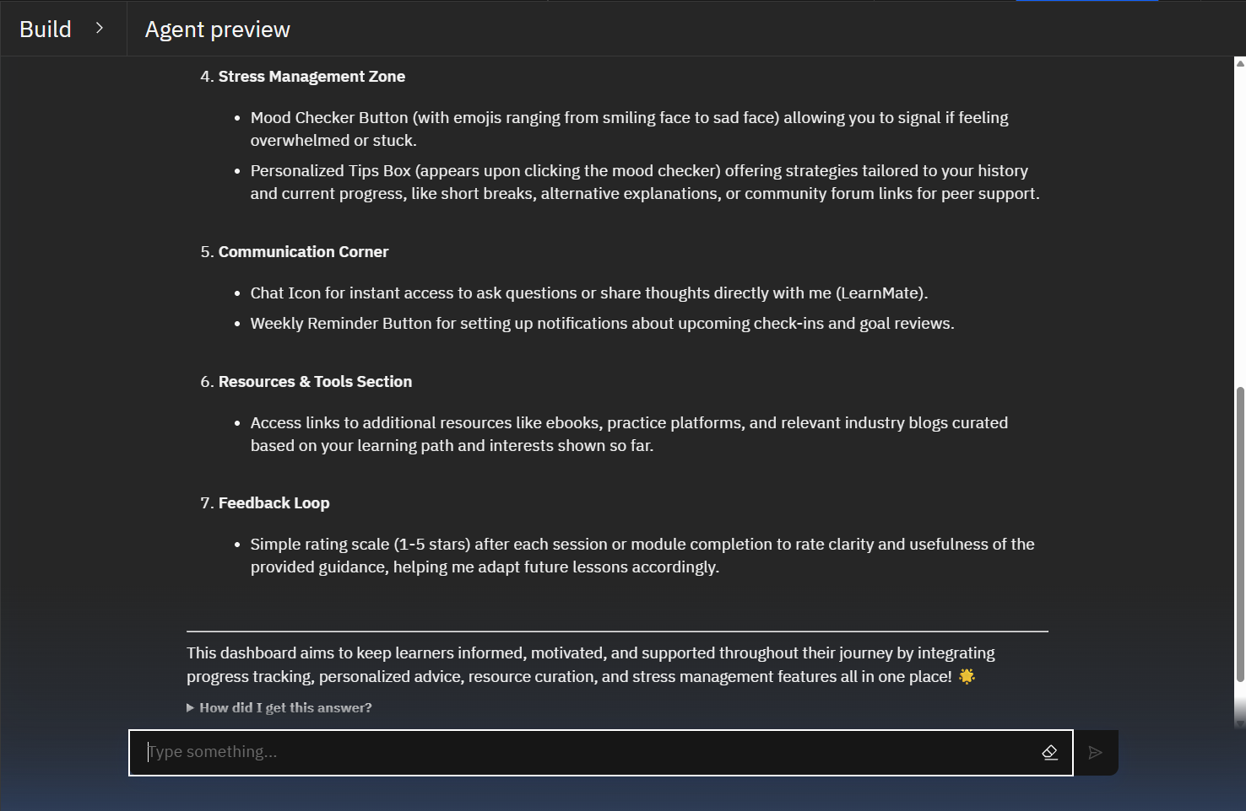
Wow factors

Slide 10





End users
Target Beneficiaries
University Students - For supplemental skill development.
Educators: Track class-wide progress gaps.
Career Transitioners - For targeted reskilling.
Corporate Departments - For employee upskilling programs.
Self-Learners - For structured autodidactic education.

Slide 11
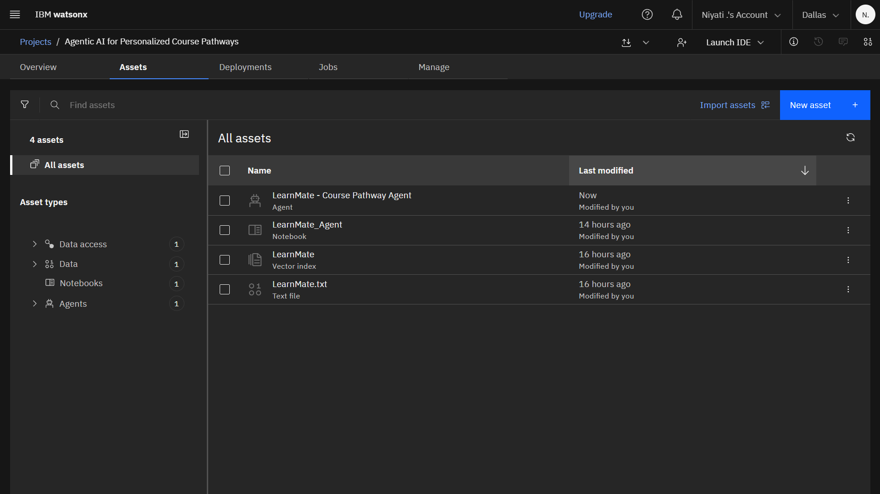
Results
Proof of Concept

Slide 12
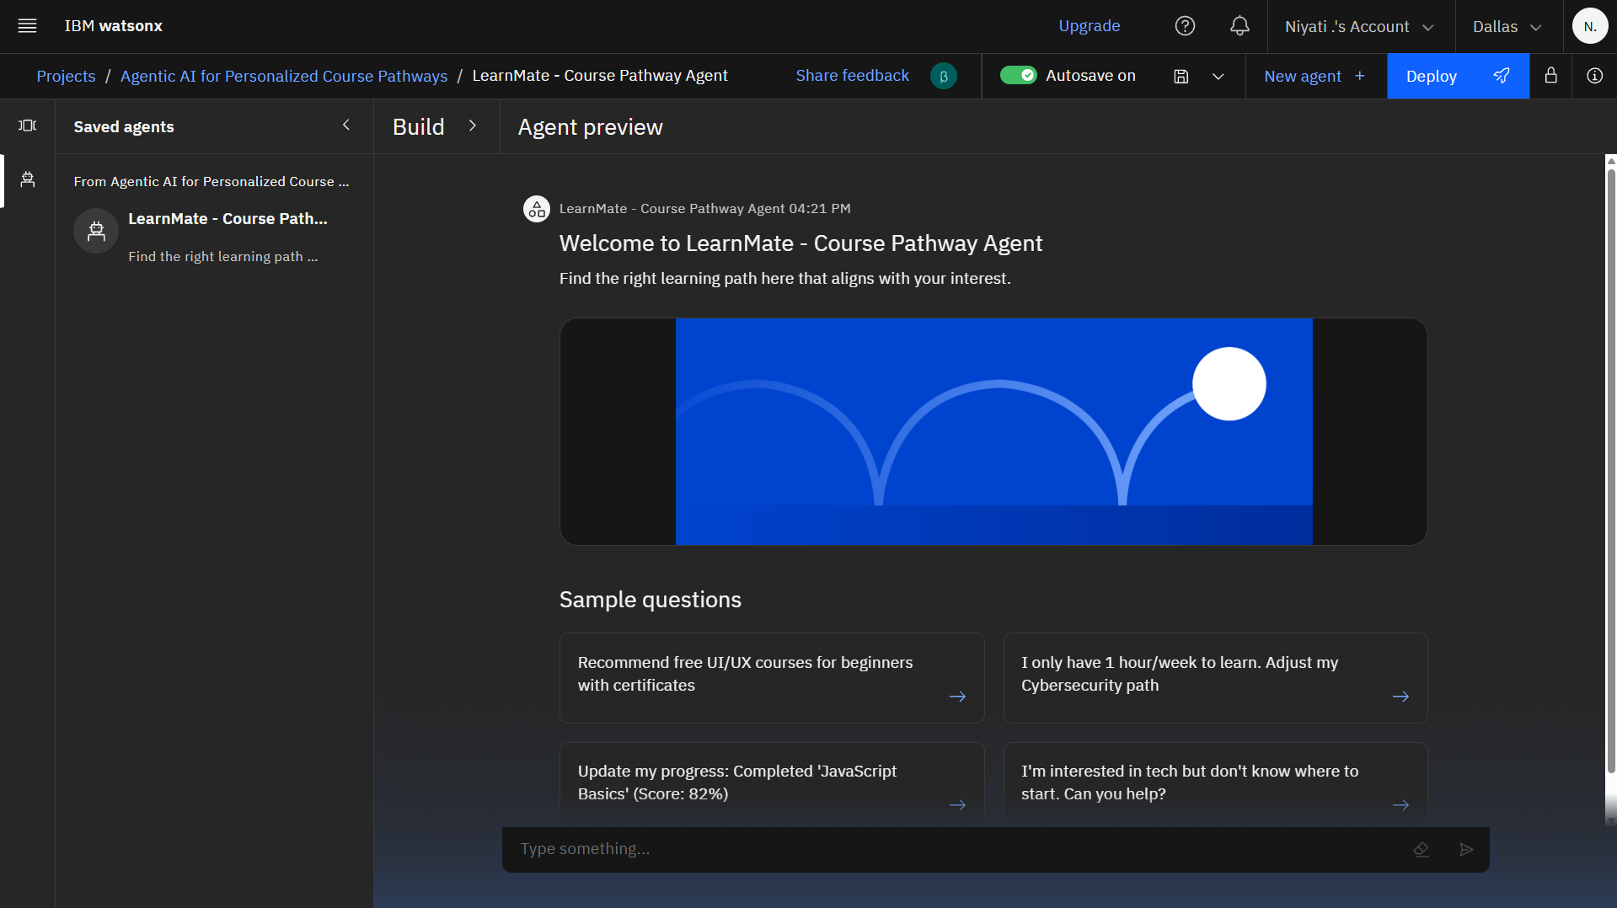
Results

Slide 13
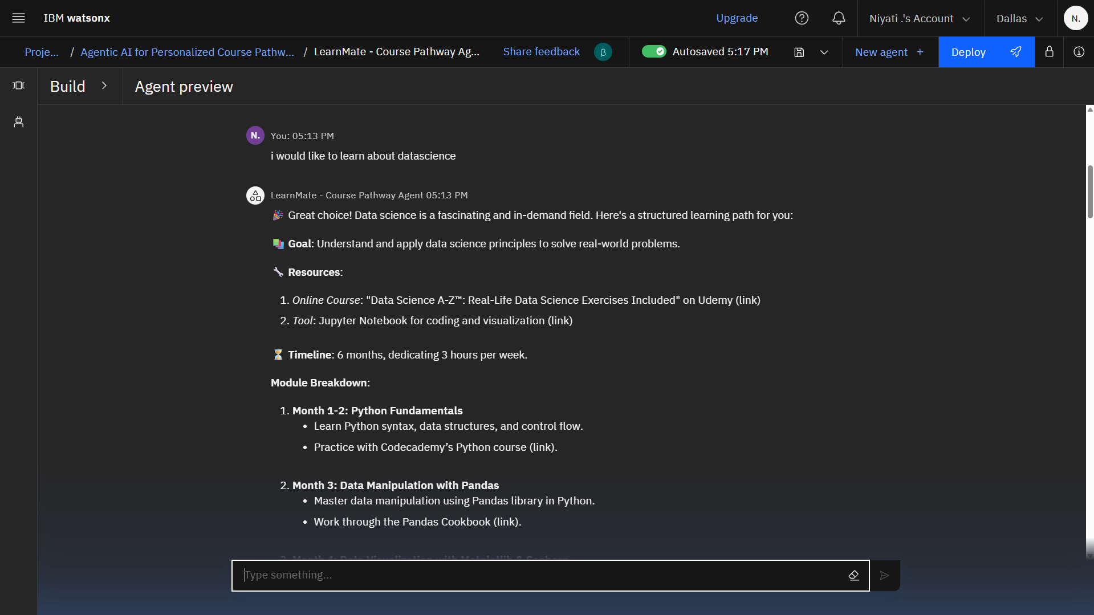
Results

Slide 14
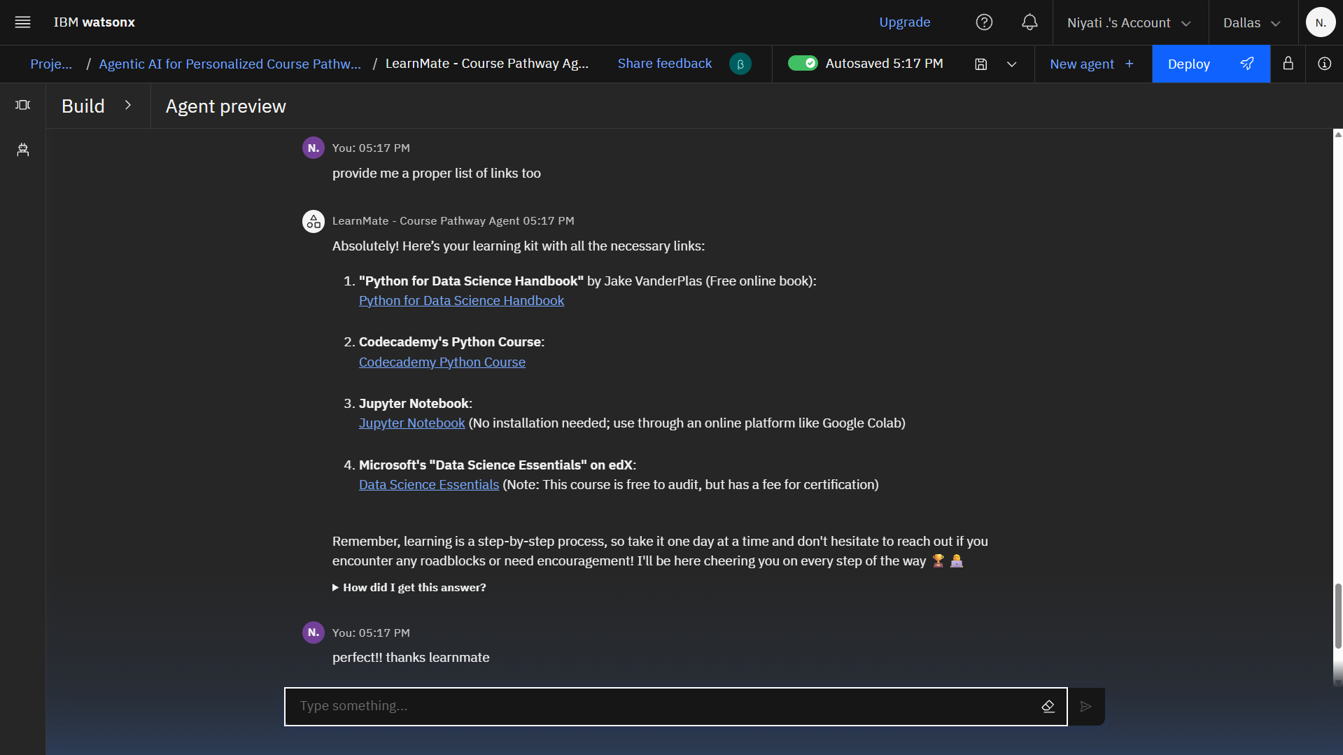
Results

Slide 15
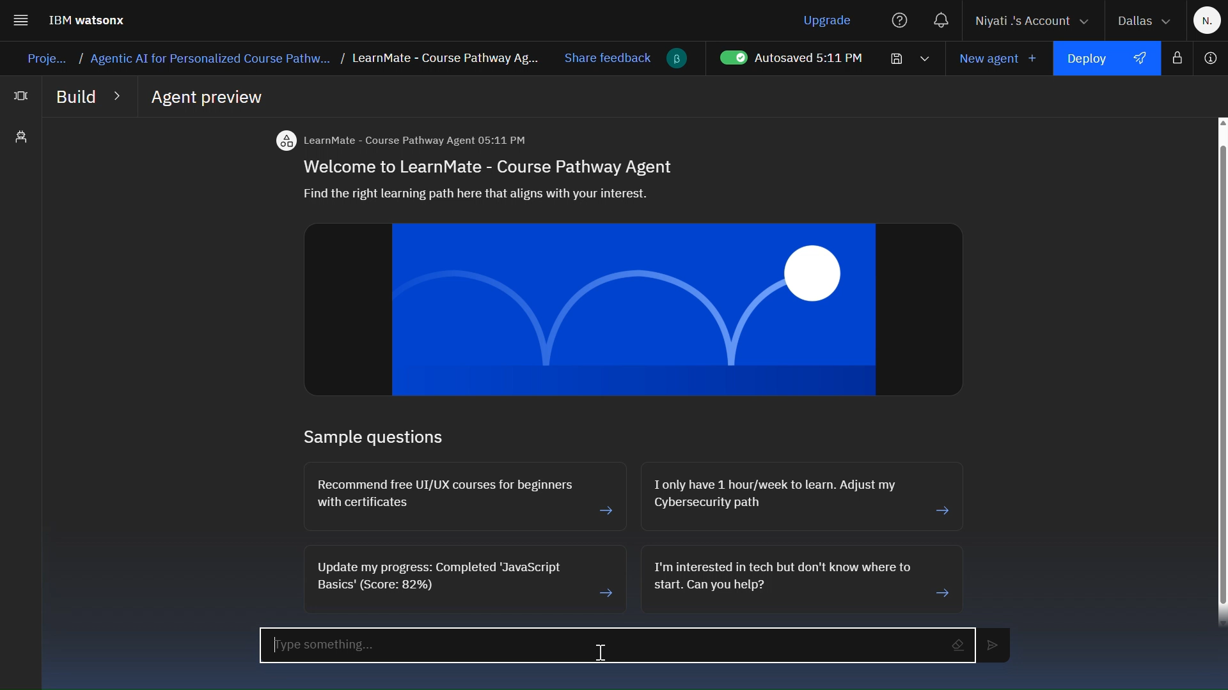

Slide 16
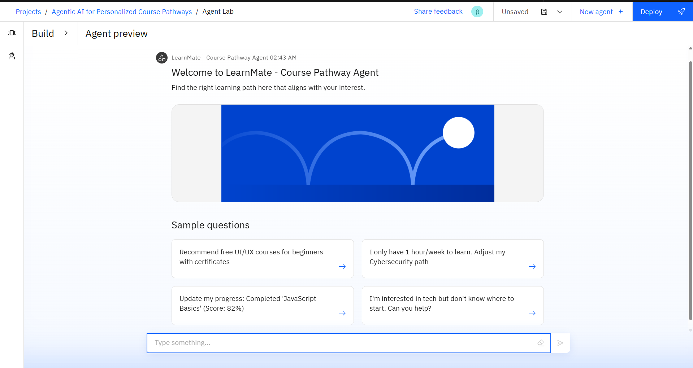
Results
Deployed AI Agent

Slide 17
Conclusion
Transforming Education with AI
LearnMate bridges the gap between learner intent and effective upskilling by:
Eliminating the "paradox of choice" in online learning
Providing truly adaptive learning experiences
Delivering measurable improvements in educational outcomes
Scaling personalised guidance cost-effectively
The system demonstrates that AI can complement human educators by handling personalisation at scale, enabling teachers to focus on higher-value interactions.

Slide 18
Future scope
AI Tutor Integration: Real-time coding assistance.
Scholarship Matching: Recommends funding opportunities.
VR Labs: Hands-on practice for fields like cybersecurity.

Slide 19
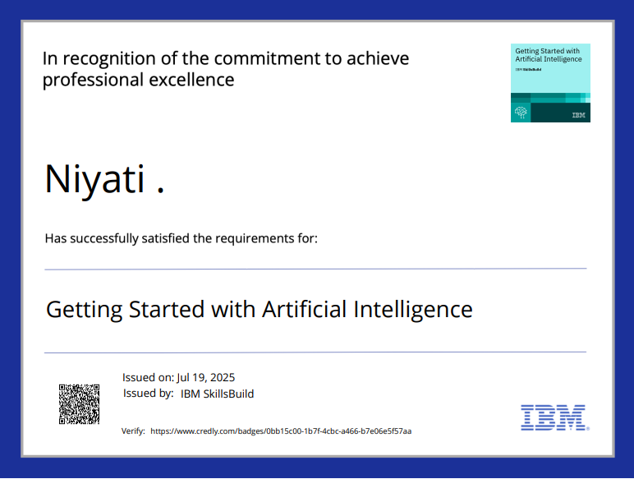
IBM Certifications

Slide 20
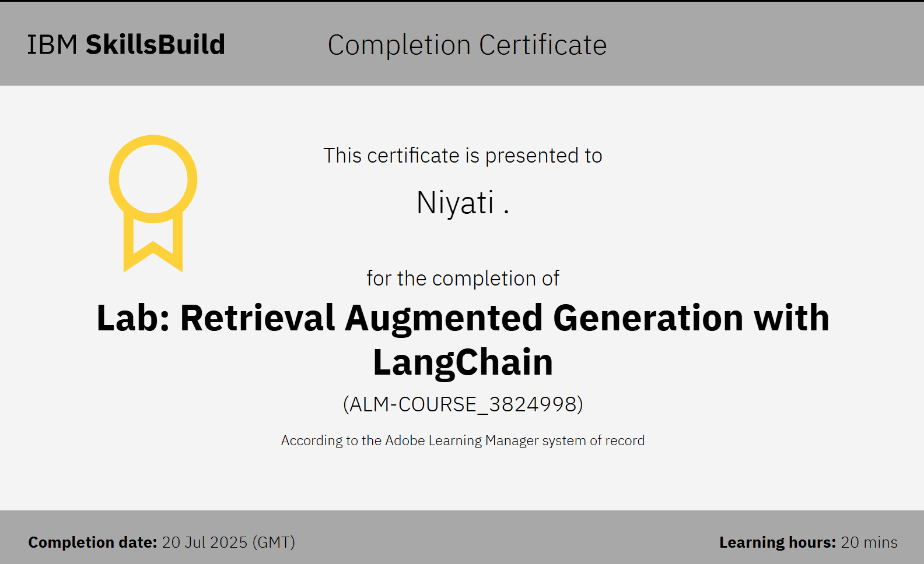

Slide 21
Github link :
https://github.com/niyati666/LearnMate_Agent

Slide 22
THANK YOU

